Slide 1

Psychological Professions Week 2025
Communication Pack
10 November 2025 – 14 November 2025
#PsychologicalProfessionsWeek2025
#PPWeek25

Slide 2

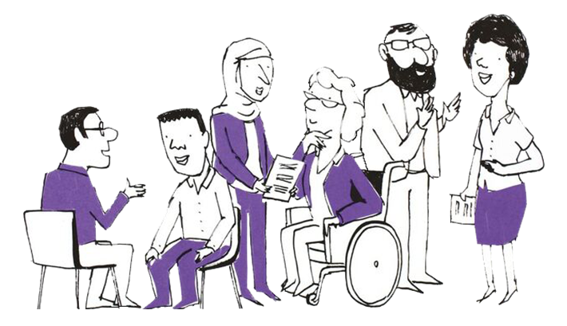
What are the Psychological Professions?
In England, the psychological professions are a group of professionals whose work is informed by psychology and psychological therapies. They work with people to alleviate psychological and emotional distress, to improve mental and physical health management and empower individuals and communities to improve their health and wellbeing.
The psychological professions include psychologists, psychological therapists and psychological practitioners.
Read more about the range of occupations Health Careers website and the PPN
Careers Map.
Our Vision
To transform lives and communities by embedding and developing
psychological knowledge and practice across the whole of health and care.
#PsychologicalProfessionsWeek2025
#PPWeek25

Slide 3
Background
There are 34,000 whole-time equivalent (WTE) psychological professionals — including psychologists, psychological therapists, and psychological practitioners — working within NHS-commissioned healthcare in England. The size of this workforce has more than doubled since 2016. Psychological professions now contribute increasingly across mental health and additional care pathways, encompassing acute healthcare, rehabilitation, and primary care.
The NHS 10-year health plan outlines a strategic transformation of healthcare over the next decade, focusing on three shifts: hospital to community, analogue to digital, and sickness to prevention. Psychological professionals are essential to the successful delivery of this plan, applying their expertise to ensure that all health and care services are psychologically informed. They lead significant pathways of care to deliver on policy objectives including NHS Talking Therapies and Mental Health Support Teams in schools and will be instrumental in achieving the three shifts in the 10 Year Health Plan.
To facilitate these aims, NHS England has established the Psychological Professions Networks (PPNs) both nationally and across the seven regions in England. These networks provide a unified voice for psychological professionals in workforce planning and development and promote excellence in practice. The PPNs currently have over 19,000 members.
Since 2020, during the second week of November, the PPNs have coordinated events dedicated to highlighting and celebrating the achievements and impact of the psychological professions as part of Psychological Professions Week.
#PsychologicalProfessionsWeek2025
#PPWeek25

Slide 4
Psychological Professions Week 2025 - Objectives
Raise awareness of the psychological professions, including careers in the psychological professions, opportunities and the workforce growth ambitions
Engage and encourage a diverse audience to attend the PPN regional webinars and events during 10-14 November 2025
Encourage physical and mental health services, education providers, professional bodies and other organisations to celebrate Psychological Professions Week by holding their own events and communications.
Increase membership of the PPNs
#PsychologicalProfessionsWeek2025
#PPWeek25

Slide 5
Psychological Professions Week 2025
- PPN Regional Events
PPN regional events are aimed at PPN members, the public and wider stakeholders so they can come together to celebrate the psychological professions. The sessions will be an opportunity to learn, engage, influence and drive strategic ambitions to develop the professional group for the benefit of patients and the public.
Throughout the week, PPN regionally led virtual and in-person events will be held.
Find out more and register for sessions: PPWeek25 Programme
For more information visit: www.ppn.nhs.uk
#PsychologicalProfessionsWeek2025
#PPWeek25

Slide 6
Psychological Professions Week 2025
Join in and be part of the movement for a more psychological NHS
This year we are again asking organisations, services, teams and individuals to develop and deliver local events and communications to celebrate the great work the psychological professions do in the NHS.
Please consider the following guidance for events and communications:
Align events and communications to the Vision for the Psychological Professions and the NHS 10 year health plan three shifts: sickness to prevention, hospital to community and analogue to digital.
Support the building of bridges between practitioners, policy, and the public
Recognise and support the unique and valuable contribution of all 21 psychological professions
Involve people with lived experience in the design and delivery of events, alongside psychological professionals (and for regional and national events, NHS England colleagues)
Demonstrate the impact the psychological professions have on delivering high quality healthcare for patients, carers, and families
Promote the delivery of national policy and local innovation in ways that are in synergy
Encourage people to join the PPN to be part of the movement for a more psychological NHS.
#PsychologicalProfessionsWeek2025
#PPWeek25

Slide 7

Psychological Professions Vision for England
#PsychologicalProfessionsWeek2025
#PPWeek25

Slide 8
How to be part of PPWeek25
We need your help to encourage colleagues, organisations and partners to mark Psychological Professions Week 2025.
You can help to do this by:
Adding the PPWeek25 email signature image to your emails during September to November
Using the PPWeek25 Teams backgrounds during October and November
Encourage people to join the PPN to be part of the movement for a more psychological NHS
Developing creative and authentic local content to promote Psychological Professions Week across your platforms
This can include profiling and telling the stories of psychological professionals, service users who have benefited from their services, sharing job and career opportunities that are available, creating blogs, posting on social media, developing local news stories, running virtual or face to face events.
#PsychologicalProfessionsWeek2025
#PPWeek25

Slide 9
How to be part of PPWeek25
You can help us do this by:
Sharing, via your channels, networks and social media, the details of Psychological Professions Week 2025, national webinar, regional events, local events, PPN website, key messages, communication assets and membership links.
Don’t forget to share your activity with us. You can also tag relevant regional PPN accounts on various social media platforms:
Psychological Professions Network North West | LinkedIn
Psychological Professions Network Midlands | LinkedIn
Psychological Professions Network South West| LinkedIn
Psychological Professions Network London | LinkedIn
Psychological Professions Network East of England | LinkedIn
Psychological Professions Network North East and Yorkshire | LinkedIn
Please use the hashtag #PPWeek25 or #PsychologicalProfessionsWeek2025 in all posts.
#PsychologicalProfessionsWeek2025
#PPWeek25

Slide 10
Key dates
02 September 2025 : Psychological Professions Week 2025 Communications Commence
29 September 2025: Registrations open for PPN Regional Events (PPWeek25 Programme) (please check individual event information)
3 November 2025: 'One week to go' communications
10 – 14 November 2025: Psychological Professions Week 2025!
#PsychologicalProfessionsWeek2025
#PPWeek25

Slide 11
Audience
Everyone is welcome to mark Psychological Professions Week 2025 across England and join the national webinar and PPN regional events!
Our audiences include:
Psychological professionals – qualified, training and aspiring
Experts by Experience and people with lived experience
Policymakers
Education, workforce and career leads and teams
NHS commissioned service providers
Members of the public interested in the psychological professions and NHS services.
#PsychologicalProfessionsWeek2025
#PPWeek25

Slide 12
Key messages
Psychological Professions Week 2025 is taking place 10-14 November 2025.
The week is led by the Psychological Professions Network and aims to celebrate the impact and highlight the potential of the psychological professions.
Join us in celebrating Psychological Professions Week 2025!
Add the Psychological Professions Week logo to your email signature and use the Teams backgrounds.
Encourage your organisations, services, team, and colleagues to develop and deliver local events and communications to celebrate the great work the psychological professions do in the NHS.
Register and attend one or more of the PPN regional sessions, and the national webinar.
View the PPN regional events programme and how to register at PPWeek25 Programme.
All PPN events are free for members!
It is FREE to become a member of Psychological Professions Network, visit www.ppn.nhs.uk. Join the PPN to be part of the movement for a more psychological NHS.
#PsychologicalProfessionsWeek2025
#PPWeek25

Slide 13
Assets
Using the link to the PPN website, you’ll find one central hub for all the Psychological Professions Week 2025 assets:
GIF
Logo
Social Card Template
Email signatures
Poster
Background Images
Communication Pack
#PsychologicalProfessionsWeek2025
#PPWeek25

Slide 14
Further information
For further information or queries, please contact your regional PPN.
PPN - East of England
PPN - London
PPN - Midlands
PPN - North East and Yorkshire
PPN - North West
PPN - South East
PPN - South West
If you require information about Psychological Professions Week 2025 or this communications pack, please contact your regional PPN.
#PsychologicalProfessionsWeek2025
#PPWeek25

